Slide 1
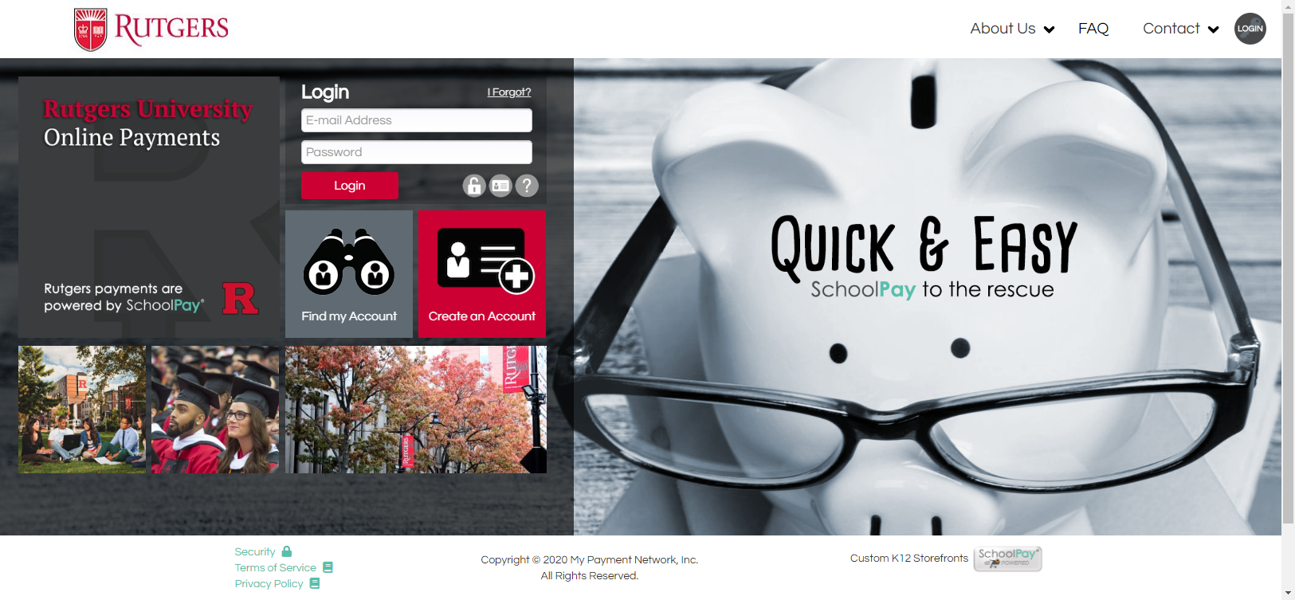
Rutgers.schoolpay.com OR www.schoolpay.com

Slide 2
Important things to know
Review Checkout Process
Minimal changes to current process
Review of Administrator Module
www.schoolpay.com or Rutgers.schoolpay.com
How to log into sub-department accounts
Reporting
Custom Reports
Refunds & Voids
Q&A

Slide 3
Important things to know
You will have the same “access” in SchoolPay as you did in Scholarchip
SchoolPay reporting will show same data
Historical transaction data will be available in SchoolPay
Refunds for Scholarchip transactions must be issued manually via paper check.
Live, toll-free support is available Monday-Friday, 7:00am – 8:00pm EST.
888-886-9729
support@schoolpay.com

Slide 4
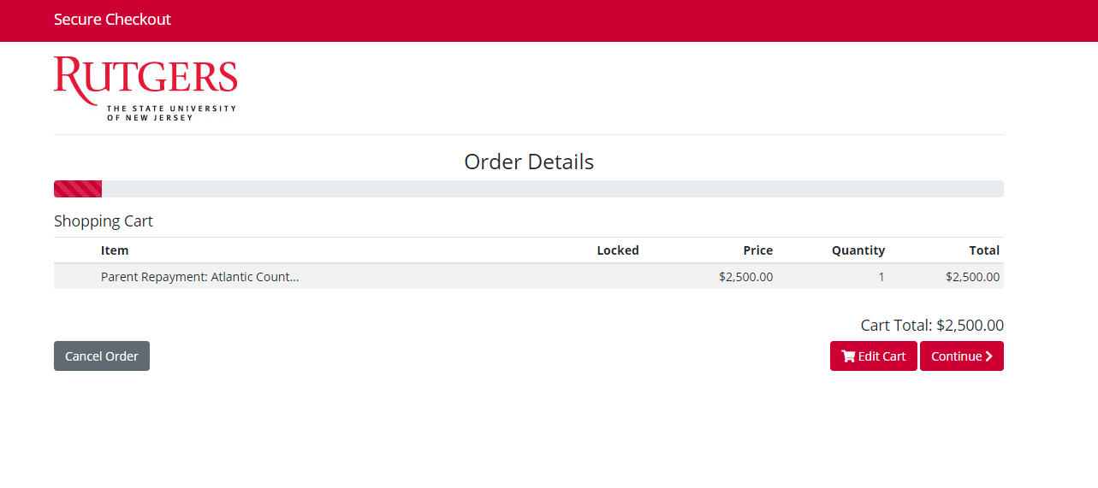

Slide 5
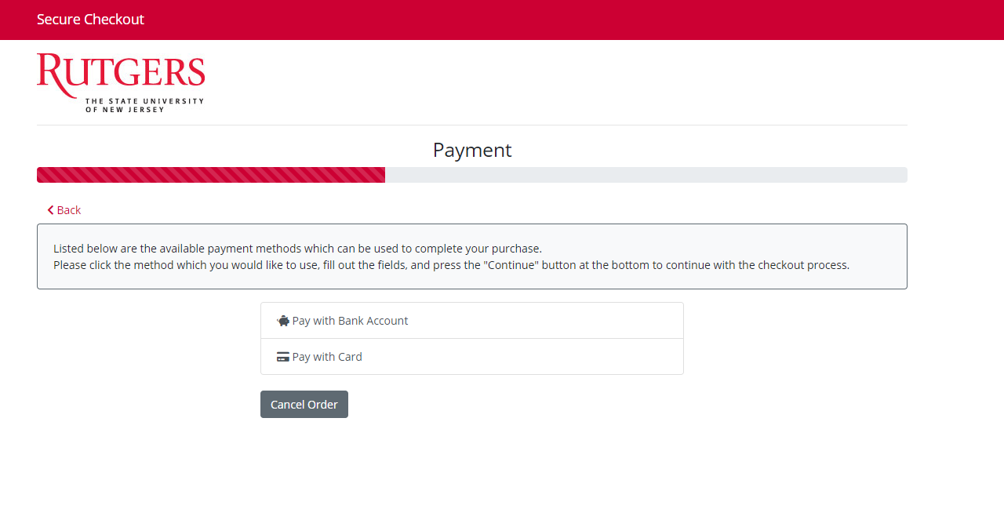

Slide 6
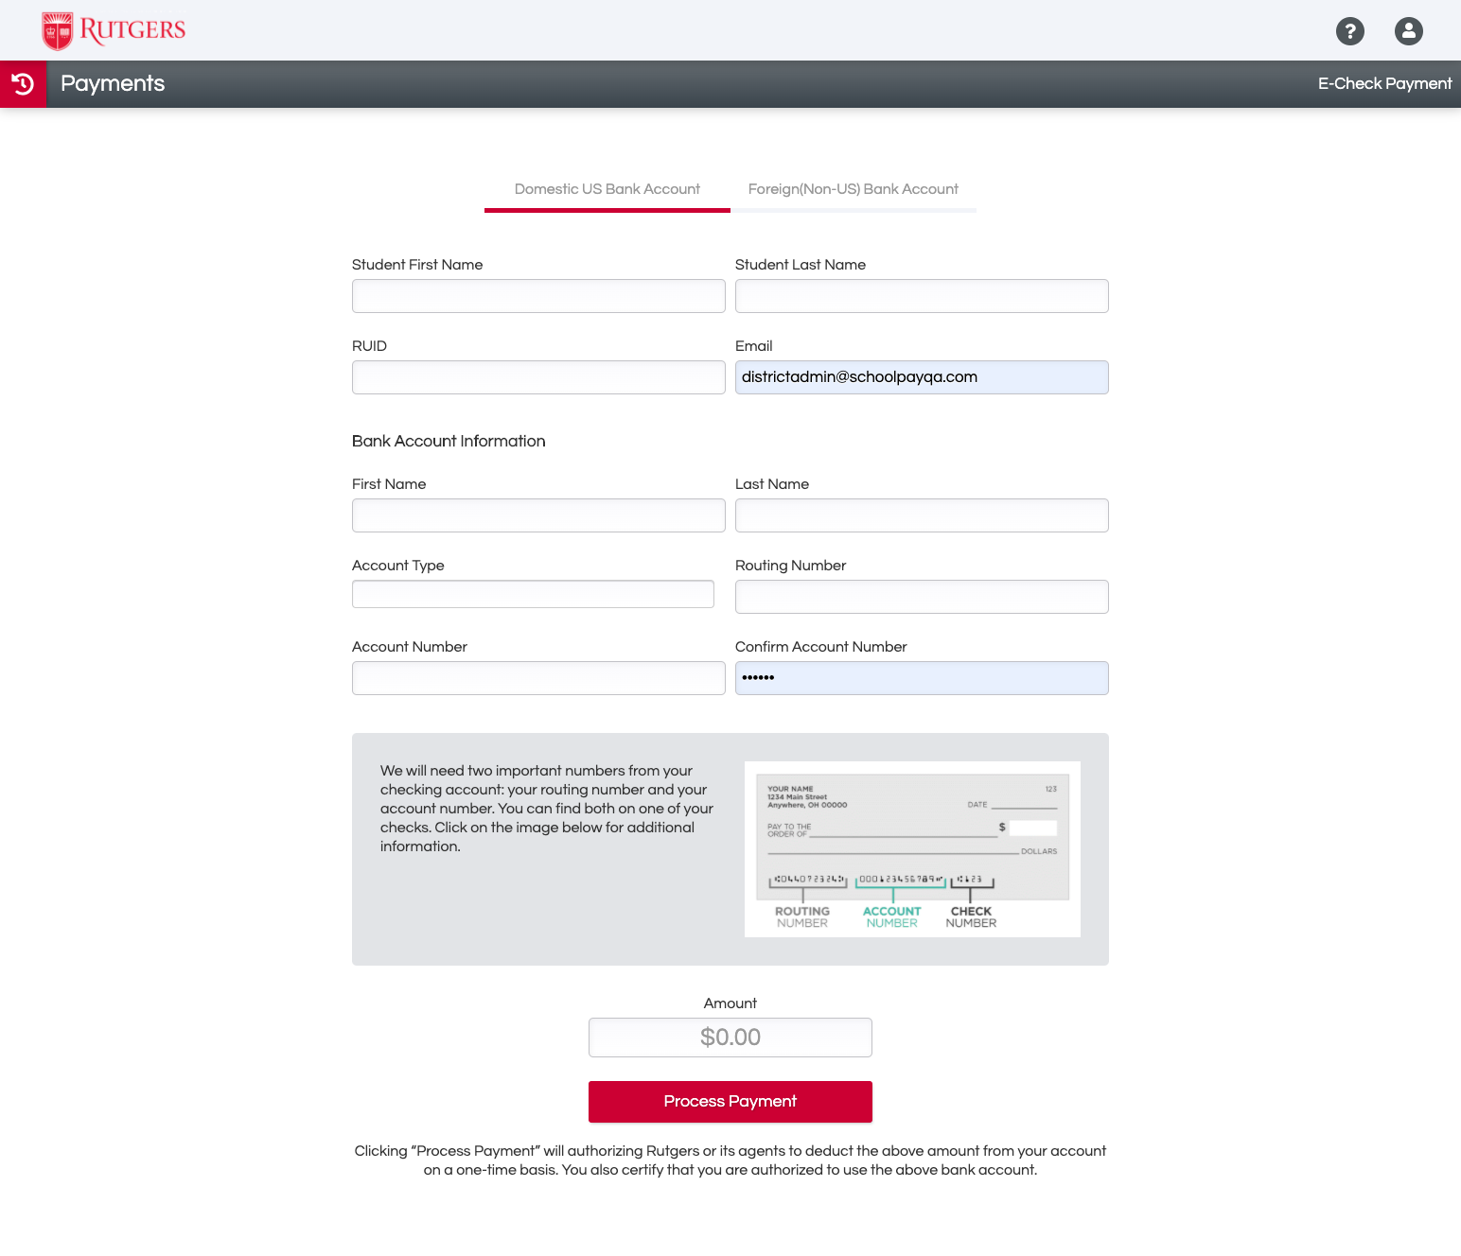

Slide 7
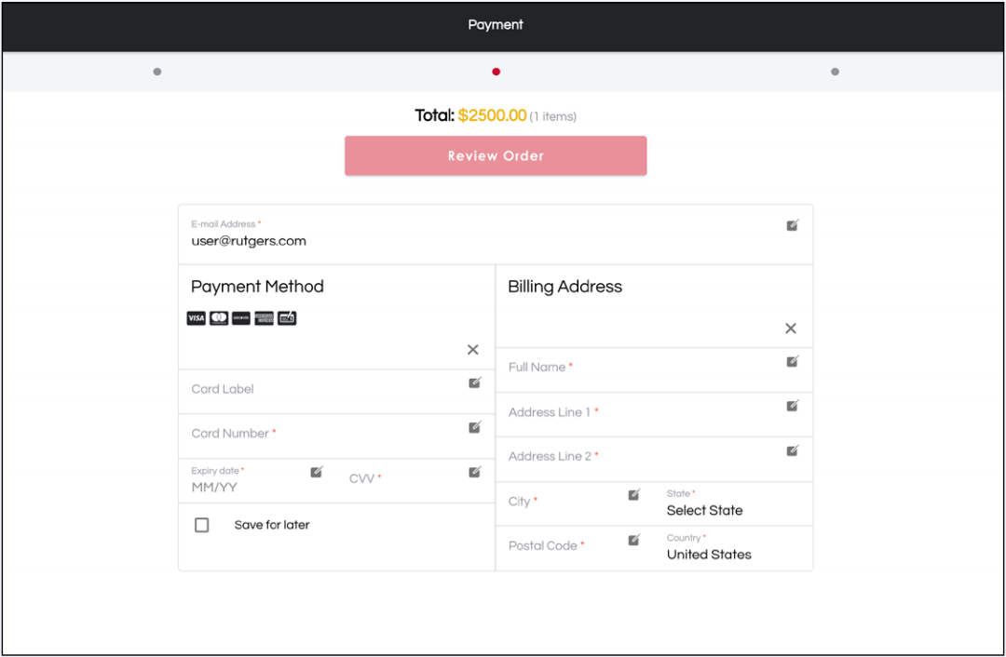

Slide 8
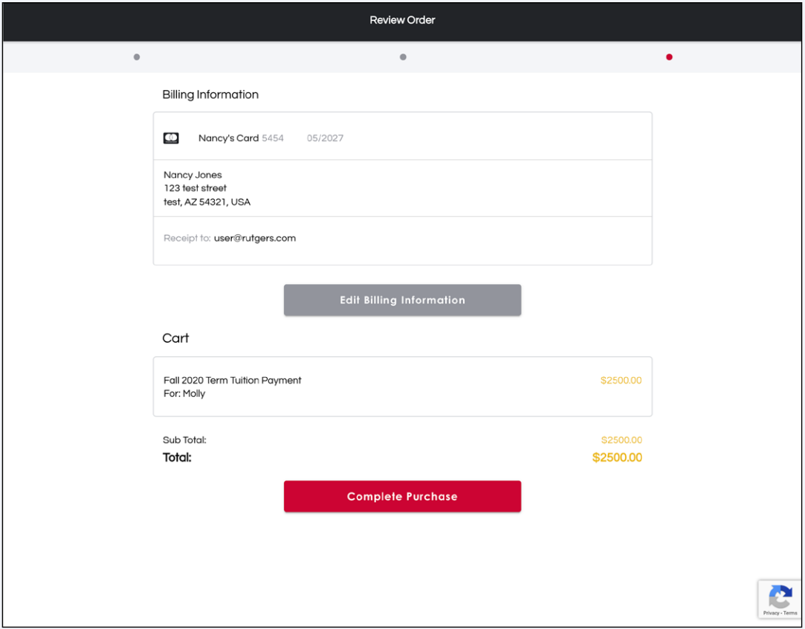

Slide 9
