Slide 1
Capital Equipment Management 2025 Equipment Audit January 2025

Slide 2
General Housekeeping for Today’s Session
Please mute your Audio during presentation
Questions can be typed in chat, and will be responded to during Q&A
During Q&A please unmute your Audio
Presentation will be available on UFA website

Slide 3
Presenters
A. Chea Smith – Associate Controller - Cost Analysis & Capital Equipment Management
University Controller’s Office
Bob Fiocco
Senior Accountant Supervisor – Capital Equipment Management
University Controller’s Office
Michael Braswell
Property Control Supervisor – Capital Equipment Management
University Controller’s Office

Slide 4
Agenda
Why Are We Here Today – An Overview
Who are we?
Rutgers University Capital Equipment Management Department (CEM)
Immediate Focus: Mandatory 2025 Capital Equipment verification
2023 Rutgers Physical Audit –Recap and Thank you
Capital Equipment Management Department’s Major Responsibilities
Business Unit Department Responsibilities for Capital Equipment Reporting in Collaboration with CEM
2025 Rutgers Business Unit Physical Audit
Q&A

Slide 5
The Need for the MANDATORY 2025 Capital Asset Inventory?
To Meet the Federally Mandated Asset Management & Financial Reporting Requirements for Rutgers University:
Independent Auditors (KPMG)
Federal Cognizant Auditors – Department of Health & Human Services – Division of Cost Allocation
Federally mandated Biennial Capital equipment verification
State of New Jersey – Office of the State Comptroller
Rutgers Asset Inventory Status:
Current through December recording acquisitions > $5,000
Recognition of Asset Transactions Such As: Transfers, Retirements/Dispositions
Reviewing Procedures for Post - Current 2025 Capital Asset Equipment Audit

Slide 6
2023 Department Equipment Audit Recap
2023 Audit highlights:
Over 90 percent participation from 275 departments. Over 15,000 assets found
Completed Federal requirements of Audit every 2 years.
Satisfied Rutgers University internal and external 2023 audit requirements
Accurate 2023 Financial reporting for Unfound and Surplus equipment
No exceptions with 250 research Grants request.
Asset Locations and all status updated in Oracle from 2023 Audit.
Lessons learned and 2025 points:
Improved reports for 2025
More time to complete : 3 months earlier.
Additional support – CEM
Additional edits for purchase orders in Marketplace
Department contacts confirmed
Over 3000 pieces of equipment already audited for 2025

Slide 7
Capital Equipment Management Department Organization
Bob Fiocco – Senior Supervisor
Michael Braswell – Supervisor of CEM
Levi Wilson - Records new equipment, tagging equipment, perform Audits & Grant reporting
Andrew Kvortek – Records new equipment, tagging equipment, perform Audits & Grant reporting. Responsible for University Vehicles (registration, plates, title & recording)
Erik Young - Records new equipment, tagging equipment, perform Audits & Grant reporting
Kevin Reynolds - Records new equipment, tagging equipment, perform Audits & Grant reporting

Slide 8
History & Background of CEM Department
December 2021: Property Management Department changed reporting to Associate Controller, Chea Smith, Cost Analysis and Capital Equipment Management.
Department name is later changed to Capital Equipment Management (CEM). More in line with CEM’s roles & responsibilities and aligns well with department responsibilities for overall asset management, cost accounting, physical space reporting financial reporting (State, Independent, & Federal Audit) and the University’s Facilities & Administrative (F&A) reporting requirements.
The Oracle Fixed Assets Module records all University-wide capital assets

Slide 9
Significance of Rutgers University’s Capital Equipment Management Department’s Oversight
Rutgers University CEM department oversees 18,000+ assets
Camden
Newark
New Brunswick
RBHS
Statewide Research Centers
Asset Investment: $680 million
$1,000,000 - $4,000,000 - Average asset additions, per month
All assets are populated in Oracle Fixed Assets Module
Records costs, disposals & adjustments
Calculates monthly depreciation
Interface to Oracle GL- monthly basis

Slide 10
CEM’s Major Responsibilities
Record all new purchases of capital equipment that are not permanently affixed to a building.
Involves daily review of purchasing reports for Rutgers University. Record/Assign:
Original Cost
Useful Life
Depreciation Calculations
Location of Asset
Perform – Monitor- Collaborate - Audit of assets
Perform Tagging of new assets
Vehicle Reporting
Grant Reporting
Month End Close – Fixed Assets

Slide 11
Business Unit Department Responsibilities for Capital Equipment Management
Maintain an Accurate Inventory for their Respective Area:
Designate a Capital Equipment Custodian responsible for your Business Unit, in collaboration with CEM
Maintain/Update the physical location accuracy of your assigned capital equipment assets
Notify Department Custodian of location changes
Contact Material Services Department for all disposals. Follow procedures as outlined in the Material Surplus System
Maintain/Update your department’s inventory of “Off Campus” assets (i.e.: Capital equipment assets located at other locations required for departmental use)

Slide 12
Current Mandatory 2025 Department Equipment Audit
Capital Equipment Management: Will work collaboratively with each Business Unit
Business Unit: Will be provided with a current fixed asset report for your department’s current capital equipment asset inventory:
Excel updatable report
Example and Demo slides ahead
2025 Capital Equipment Audit Report:
Business Unit will be required to confirm each capital equipment asset at the current reported location. If the asset location or serial # are incorrect, update on report. ( demo slide )
Report must be completed and returned by April 30th, to your assigned CEM team representative
Untagged Assets: The accurate location information is of paramount importance, as post verification, the CEM team, with the department assistance, will need to continue tagging.
-

Slide 13
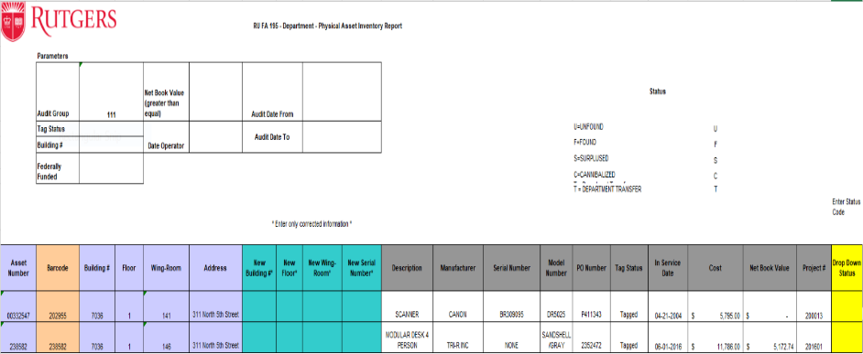
* Barcodes that have a letter as a suffix, represent split funding for a single asset. Only the first six digit needs to be verified. The suffix letters do not appear on the barcode on the physical asset.
Assets beginning with a “8” are vehicles. Floor 88 is default for vehicles.
Detail step by step instruction will be sent to your email
Training session will be scheduled for later in month 30-45 minutes. (Attend 1 or request demo from CEM team)

Slide 14
Relevant information or notes can be added to each record in column AA.
If the asset is already Tagged with a Property Barcode and shows NOT TAGGED in column P please put TAGGED in the NOTES column AA.

Slide 15
Mandatory- 2025 Department Equipment Audit (cont.)
Status
Found – Equipment Located
Unfound – Equipment Not Located
CEM Supervisor Will Follow Up with Department Head for Approval to Remove the Identified Asset from the Rutgers University Fixed Asset System
Surplused – Equipment That Has Been Surplused to Material Surplus
Business Unit Must Send to CEM the Completed Material Services Surplus Form
If Required Documentation is Not Available, the Designated Asset Will Be Considered as Unfound.
Cannibalized – Equipment Utilized for Parts
CEM Team Member will Follow Up with the Appropriate Cannibalization Form
Accounting Note
Depreciation impacted for Unfound & Surplused When Net Book Value GT $0.0
-

Slide 16
Example – Bar Code

Slide 17
Mandatory 2025 Department Equipment Audit
Next Steps
Assigned Capital Equipment team member will contact you and send the appropriate department report
If the Audit Group needs to be updated, please advise CEM ASAP
If you are not designated custodian for entire audit please advise.
Please send back updated Excel spreadsheet to CEM team member by 04/30/2025
CEM plans on having post audit lessons learned to expedite
Building Audit
Barcoding Software
Tracking Devices
Etc.

Slide 18
Q
&
A
QUESTIONS & ANSWERS

